Slide 1
Ridesharing
—— indexing, prediction, and dispatching

Slide 2
Outline
Ridesharing Problem
Optimization Goals
Hardness
Indexing
Prediction
Dispatching

Slide 3
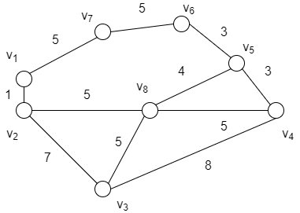




Ridesharing Problem
Description
Road network
undirected graph
$$G=\left\langle V,E\right\rangle$$
vertices set
$$V=\left\{v_{k}\right\}$$
edge set
$$E=\left\{e_{k}\right\}$$
edge cost
$$cost(e_{k})$$
travel time / transportation cost / distance

Slide 4

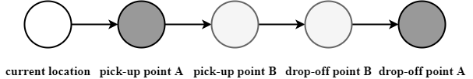

Ridesharing Problem
Description
Drivers
$$d=\left\langle id,current location,capacity,request list,schedule\right\rangle$$
taxi
private car
If the vehicle is a private car, we need to add a destination point.

Slide 5
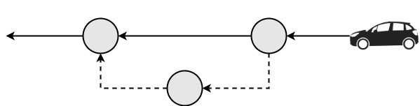
Ridesharing Problem
Description
Requests
$$r=\left\langle id,number of riders, pick−up point,drop−off point,pick−up time window,drop−off time window\right\rangle$$
In some papers, the drop-off time constraint is represented by the detour limits.

Slide 6
Ridesharing Problem
Description
Constraints
Point order : The requesting point must happen before the pick-up point, which must happen before its destination point.
Waiting time constraint : For any trip, the distance from the server’s location when the request is made to the request’s pick-up point should be smaller than the waiting time constraint.
Service constraint : For any vehicle trip schedule, the actual travel distance from a start location to a destination should not exceed a certain limit.
Capacity constraint : At any time, the number of passengers in a vehicle is no larger than its capacity.

Slide 7
Ridesharing Problem
Definition
Given vehicles and customers on a road network, the goal of the Ridesharing Problem (RSP) is to find the appropriate set of vehicle routes that can serve all customers, subject to the above constraints.
Online Assignment
In the online problem, vehicles and customers are not known beforehand, but revealed throughout the day at their early times. Each revealed customer should be assigned to a vehicle that is in service, and then the route for that vehicle must be adjusted in order for it to serve the customer.

Slide 8
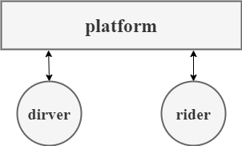
Optimization Goals
Summary
Common
maximize the number of matched requests
minimize the total travel distance / time
Platform
maximize the overall profit
Driver
maximize the profit per day
Rider
minimize the waiting time
minimize the unit cost
minimize the travel time

Slide 9
Optimization Goals
(IJCAI 2011) A Mechanism for Dynamic Ride Sharing Based on Parallel Auctions.
minimize total travel distance & maximize the number of matched requests
(IJCAI 2013) Dynamic Taxi and Ridesharing: A Framework and Heuristics for the Optimization Problem.
maximize the number of matched requests
(ICDE 2013) T-share: A large-scale dynamic taxi ridesharing service.
maximize the number of matched requests
(VLDB 2014) Large Scale Real-time Ridesharing with Service Guarantee on Road Networks.
minimize total travel time
(IJCAI 2016) An Online Mechanism for Ridesharing in Autonomous Mobility-on-Demand Systems.
minimize the cost per unit effective demand

Slide 10
Optimization Goals
(VLDB 2018) PTRider: A Price-and-Time-Aware Ridesharing System.
return multiple options
(VLDB 2018) Order Dispatch in Price-aware Ridesharing.
maximize profit of the platform
(VLDB 2018) A unified approach to route planning for shared mobility.
minimize the weighted total distance and the penalty of unserved requests
(ICDE 2018) Price-and-Time-Aware Dynamic Ridesharing.
return multiple options
(WWW 2019) Globally-Optimized Realtime Supply-Demand Matching in On-Demand Ridesharing.
maximize the number of matched requests

Slide 11
Optimization Goals
(WWW 2019) Efficient Ridesharing Order Dispatching with Mean Field Multi-Agent Reinforcement Learning.
maximize driver’s profit per day
(IJCAI 2019) Dispatching Through Pricing: Modeling Ride-Sharing and Designing Dynamic Prices.
design pricing schemes that induce desirable supplies and demands
(ICDE 2019) Auction-Based Order Dispatch and Pricing in Ridesharing.
maximize overall utility of the auction
(ICDE 2019) An Efficient Insertion Operator in Dynamic Ridesharing Services.
minimize the maximum waiting time / minimize overall travel time
(ICDE 2019) A Queueing-Theoretic Framework for Vehicle Dispatching in Dynamic Car-Hailing.
maximize profit of the platform

Slide 12
Optimization Goals
Summary
multi-objective
take two or more goals into consideration
use the skyline method to return multiple options
common
maximize the number of matched requests
minimize the total travel distance / time
social utility
analyze the interest relation among each subject

Slide 13
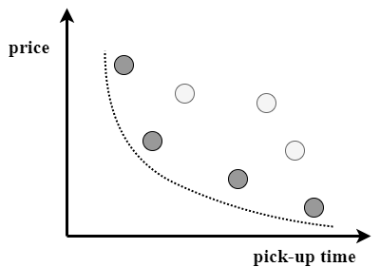
Optimization Goals
(ICDE 2001) The Skyline Operator.
(ICDE 2018) Price-and-Time-Aware Dynamic Ridesharing.
The Skyline Method
Suppose you are going on holiday to Nassau and you are looking for a hotel that is cheap and close to the beach. Unfortunately, these two goals are complementary.
The Skyline is defined as those points which are not dominated by any other point. A point dominates another point if it is as good or better in all dimensions and better in at least one dimension.

Slide 14

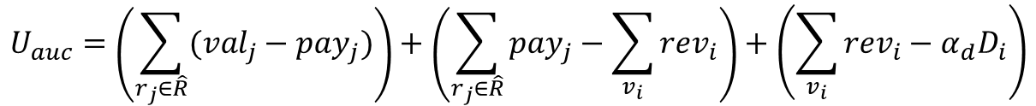

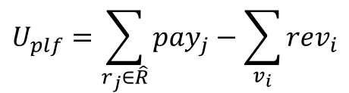
Optimization Goals
(ICDE 2019) Auction-Based Order Dispatch and Pricing in Ridesharing.
Social Utility
valuation of service
Requester’s utility
$$u_{j}=({val}_{j}−{pay}_{j})∙x_{j}$$
dispatched or not
final payment
Platform’s utility
$$U_{plf}=\sum_{r_{j}∈\hat{R}}{{pay}_{j}}−\sum_{v_{i}}{{rev}_{i}}$$
the driver’s revenue
measures the labor & fuel cost per unit travel distance
Driver’s utility
$$u_{i}={rev}_{i}−α_{d}D_{i}$$
the travel distance
$$U_{auc}=\left(\sum_{r_{j}∈\hat{R}}{({val}_{j}−{pay}_{j})}\right)+\left(\sum_{r_{j}∈\hat{R}}{{pay}_{j}}−\sum_{v_{i}}{{rev}_{i}}\right)+\left(\sum_{v_{i}}{{rev}_{i}−α_{d}D_{i}}\right)$$
Overall utility

Slide 15
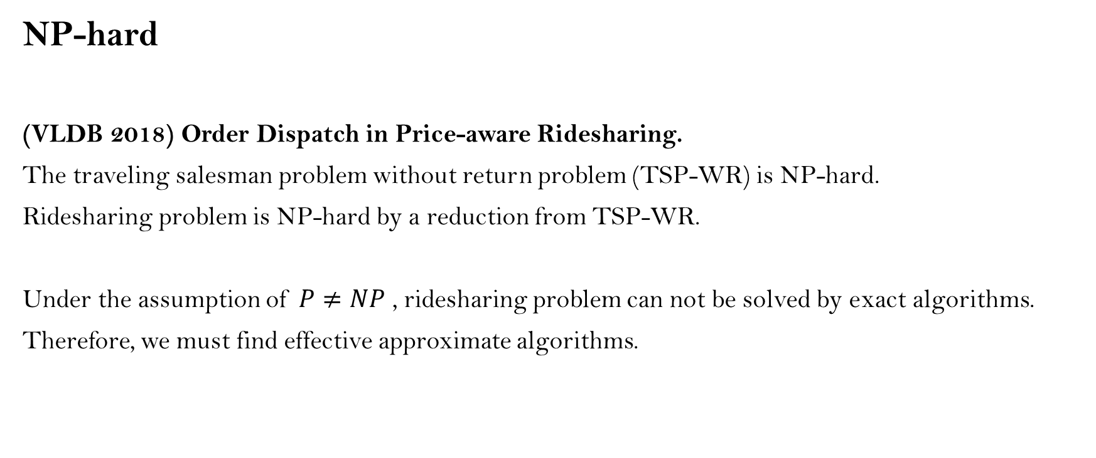
Hardness
NP-hard
(VLDB 2018) Order Dispatch in Price-aware Ridesharing.
The traveling salesman problem without return problem (TSP-WR) is NP-hard.
Ridesharing problem is NP-hard by a reduction from TSP-WR.
Under the assumption of $P≠NP$ , ridesharing problem can not be solved by exact algorithms.
Therefore, we must find effective approximate algorithms.

Slide 16

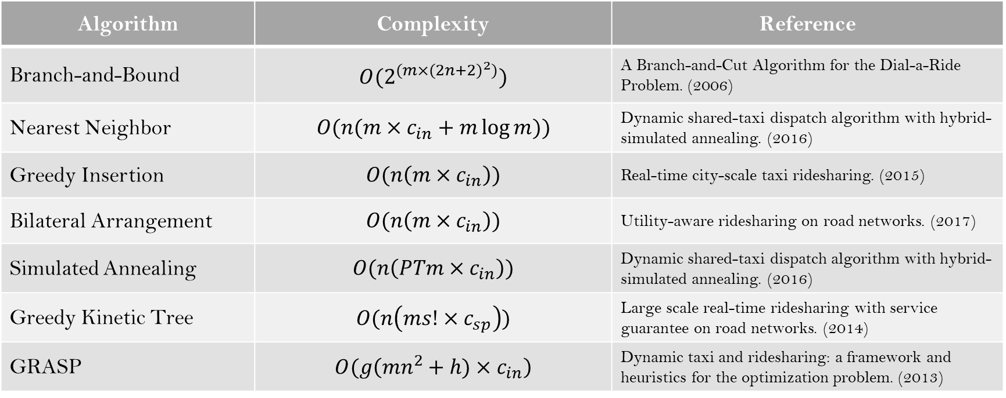






Hardness
(VLDB 2019) Ridesharing: Simulator, Benchmark, and Evaluation.
Algorithm | Complexity | Reference
Branch-and-Bound | $$O(2^{(m×{(2n+2)}^{2})})$$ | A Branch-and-Cut Algorithm for the Dial-a-Ride Problem. (2006)
Nearest Neighbor | $$O(n(m×c_{in}+m\log{m}))$$ | Dynamic shared-taxi dispatch algorithm with hybrid-simulated annealing. (2016)
Greedy Insertion | $$O(n\left(m×c_{in}\right))$$ | Real-time city-scale taxi ridesharing. (2015)
Bilateral Arrangement | $$O(n\left(m×c_{in}\right))$$ | Utility-aware ridesharing on road networks. (2017)
Simulated Annealing | $$O(n\left(PTm×c_{in}\right))$$ | Dynamic shared-taxi dispatch algorithm with hybrid-simulated annealing. (2016)
Greedy Kinetic Tree | $$O(n\left(ms!×c_{sp}\right))$$ | Large scale real-time ridesharing with service guarantee on road networks. (2014)
GRASP | $$O(g\left(mn^{2}+h)×c_{in}\right)$$ | Dynamic taxi and ridesharing: a framework and heuristics for the optimization problem. (2013)
$m$ vehicles
$n$ requests
$c_{in}$ the customer insertion cost
$s$ schedule length
$c_{sp}$ the cost of finding one shortest path
$P$ perturbations
$T$ temperatures

Slide 17
Indexing
Overview of existing methods
grid index
(ICDE 2013) T-share: A large-scale dynamic taxi ridesharing service.
(VLDB 2018) PTRider: A Price-and-Time-Aware Ridesharing System.
hexagon index
(WWW 2019) Globally-Optimized Realtime Supply-Demand Matching in On-Demand Ridesharing.
(ICDE 2019) A Queueing-Theoretic Framework for Vehicle Dispatching in Dynamic Car-Hailing.
hierarchical discretization
(ICDE 2017) Xhare-a-Ride: A Search Optimized Dynamic Ride Sharing System with Approximation Guarantee.

Slide 18
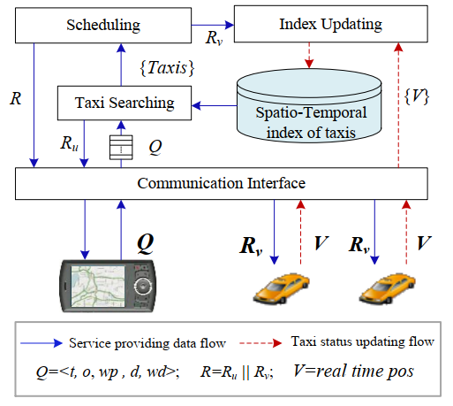
Indexing
(ICDE 2013) T-share: A large-scale dynamic taxi ridesharing service.
Grid Index
The system maintains spatio-temporal index of the taxis for the purpose of fast user query processing.
The index will be updated once a new status of a taxi is received or a taxi’s route is re-scheduled by the service.
For each query at the top of the query queue, the system invokes the Taxi Searching module to search for a set of candidate taxis {taxis} which is likely to satisfy the query based on the latest index.

Slide 19
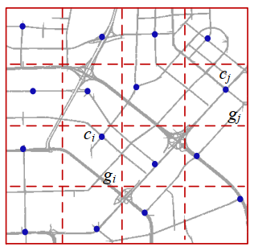
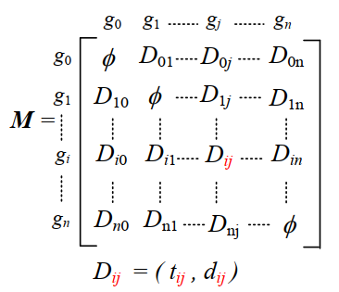
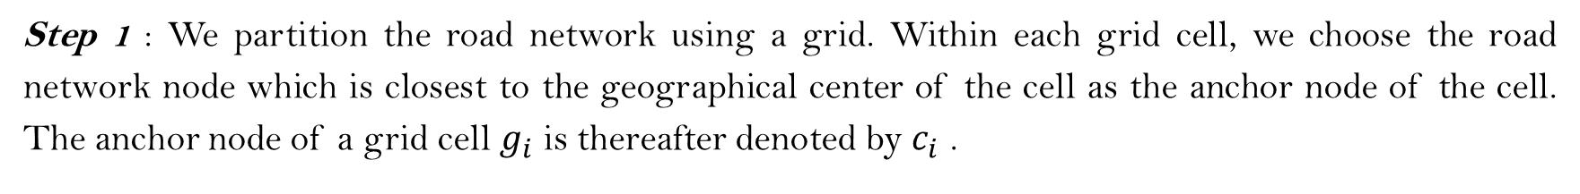
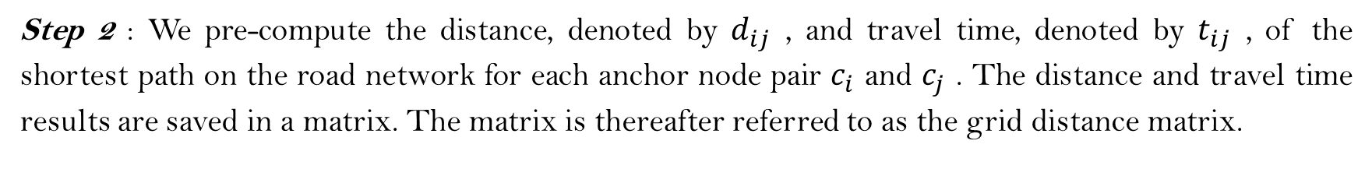
Step 1 : We partition the road network using a grid. Within each grid cell, we choose the road network node which is closest to the geographical center of the cell as the anchor node of the cell. The anchor node of a grid cell $g_{i}$ is thereafter denoted by $c_{i}$ .
Step 2 : We pre-compute the distance, denoted by $d_{ij}$ , and travel time, denoted by $t_{ij}$ , of the shortest path on the road network for each anchor node pair $c_{i}$ and $c_{j}$ . The distance and travel time results are saved in a matrix. The matrix is thereafter referred to as the grid distance matrix.

Slide 20
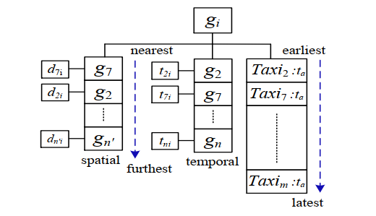
Step 3 : Now imagine that each grid cell collapses to its anchor node, that is, all the points in one cell fall to its anchor node. Then the distance between any two arbitrary points equals to the distance between two corresponding anchor nodes.
Step 4 : Each cell has some internal data structure for the purpose of taxi searching.
a spatially-ordered grid cell list
a taxi list
a temporally-ordered grid cell list

Slide 21
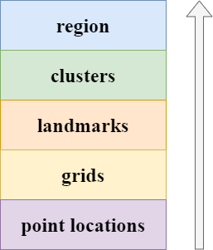
Indexing
(ICDE 2017) Xhare-a-Ride: A Search Optimized Dynamic Ride Sharing System with Approximation Guarantee.
Hierarchical Discretization
A grid is defined as a bounded square geographical region.
Any location is numerically mapped to a unique grid, given its latitude and longitude.
We identify a grid by its centroid, and henceforth wherever we refer to distances from a grid, these are measured with respect to the centroid of the grid.
A landmark is a point of interest in a geographical region, such as a bus stop, a mall or an important building, such that it is sufficiently far (at least a pre-specified distance away) from any other landmark.
Each landmark is associated with a set of grids, and each grid is associated with a unique landmark, that minimizes the maximum driving distance of the grid from the landmark.
A cluster is defined as a collection of landmarks, such that no pair of landmarks in a cluster are more than a specified δ driving distance away.
With each grid, apart from the nearest landmark information, we additionally maintain a list of “walkable clusters”.

Slide 22
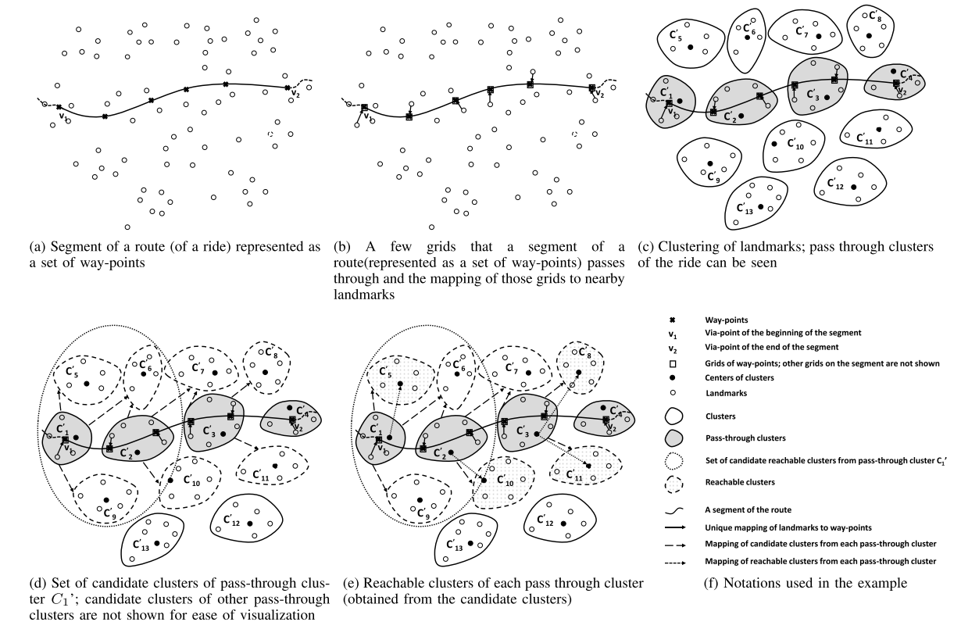

Slide 23
Prediction
The efficiency of dispatching may be affected by several factors :
Supply-demand gap
Traffic condition
Weather condition
Example :
(ICDE 2017) DeepSD: Supply-Demand Prediction for Online Car-Hailing Services Using Deep Neural Networks.
(WWW 2019) Globally-Optimized Realtime Supply-Demand Matching in On-Demand Ridesharing.

Slide 24
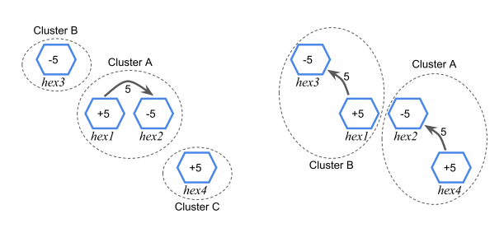
GORM
Step 1 : Perform time series forecasting (with confidence intervals) for demand and supply in the next 5 minutes in the whole market. (ARIMA)
Step 2 : Perform optimization on the global matching problem, taking as the input the demand/supply forecasting across the whole market over the next 5-minute window. As a result, we solve the problem optimizing the whole market’s efficiency over the next 5 minutes.
Step 3 : Perform real-time supply-demand matching for each individual trip request, based on the globally optimized inter-hexagon supply flows from Step 2.

Slide 25
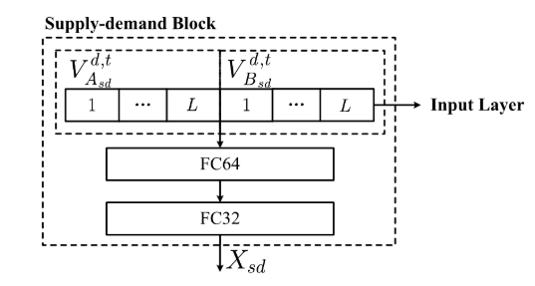
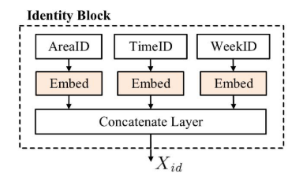
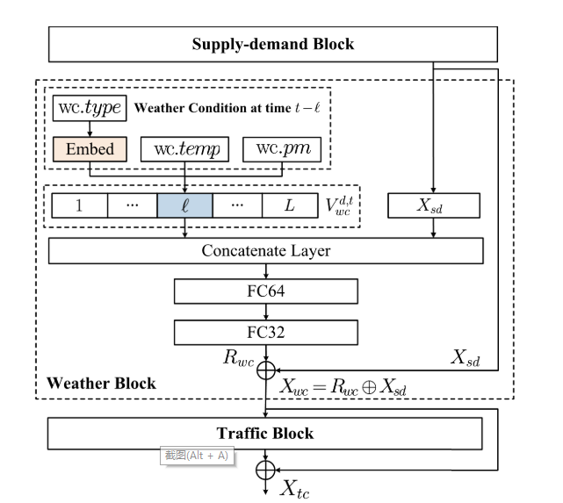
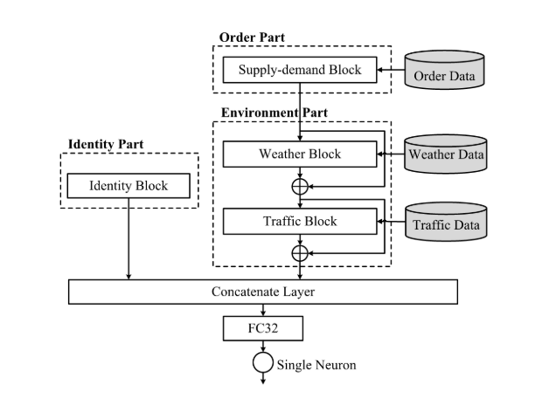
DeepSD

Slide 26
Dispatching
Search Algorithms
Each time a request comes in, the platform looks for a suitable place to insert it in an existing schedule.
Strength : instantaneity
Weakness : efficiency
Join Algorithms
At regular intervals, the platform matches the set of requests with the set of vehicles on the road network.
Strength : efficiency
Weakness : instantaneity

